Slide 1
Design and Analysis of Textile Based flexible Antenna for Ultra Wide Band
Submitted By
Shalini Upadhyay 117
Chandan Maddheshiya 081
Nidhi Patel 099
Sumit Narayan Singh 126
Ritik Viswakarma 110
Guide/Co-Guide
Er. Neeraj Kumar/ V.K Singh

Slide 2
Objective
Small size
Unique design
Cost effective
High Gain
SAR minimization
Return loss is appropriate

Slide 3
Parameters
Gain
Bandwidth
Radiation pattern
Impedance
Efficiency

Slide 4
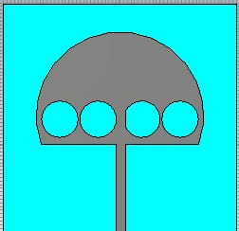
Antenna design
Flexible and light weighted
Wearable
Optimized
A wearable antenna based on “Jeans” (as substrate) with dielectric constant of 1.7 will be quite effective for application of Ultra Wide Band.
When it is designed on textile-based substrate so it’s performance will not be affected by binding.

Slide 5
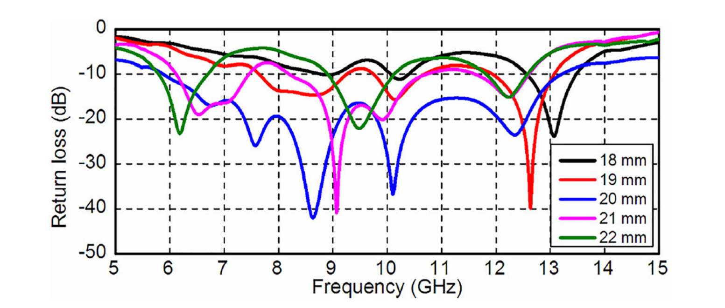
Effects of varying patch radius

Slide 6
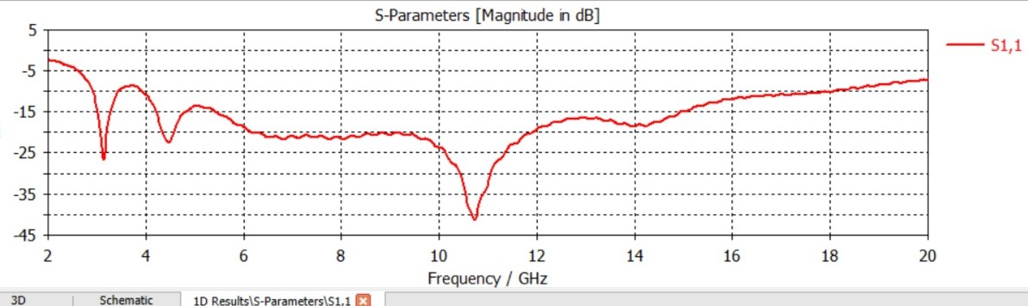
S-Parameter
The reason why we are taking RL values at -10dB is because it is a common criterion for determining the bandwidth of a network.
RL value is less than or equal to -10 dB, which corresponds to a SWR of 2:1 or less.
This means that the network has a good impedance match and a low reflection over the bandwidth

Slide 7
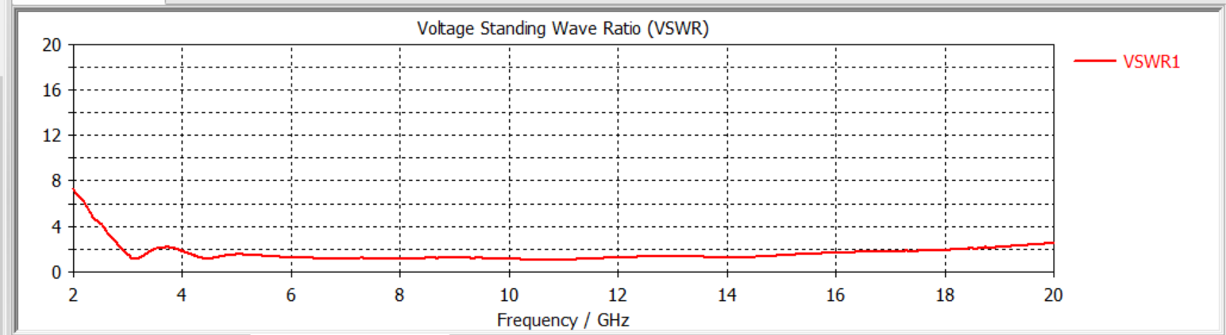
Voltage Standing Wave Ratio

Slide 8
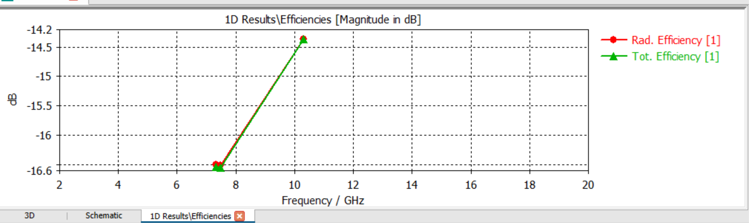
Efficiency of Antenna
The ratio of the radiated power of an antenna to the input power accepted by the antenna. Efficiency measures how well an antenna converts the input power into electromagnetic waves. It is affected by the losses in the antenna materials, the feed line, and the surrounding environment. A higher efficiency means a more effective antenna.

Slide 9
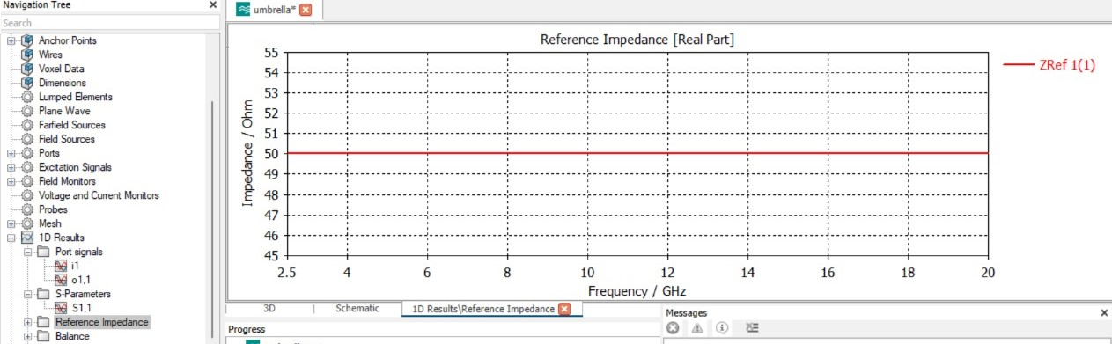
Impedence
The ratio of the voltage to the current at the input terminals of an antenna. Impedance is a complex quantity that consists of a real part called resistance and an imaginary part called reactance. Impedance determines how well an antenna is matched to its feed line and transmitter or receiver. A good impedance match means minimal reflection and maximum power transfer.

Slide 10
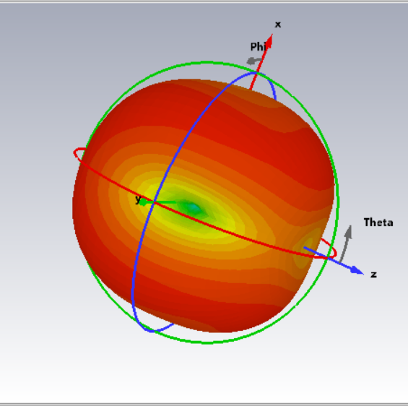
Radiation Pattern

Slide 11

Plans for 8th Semester
We will design the Hardware.
Tested on the basis of software.
Bending effect of antenna
Experimental results

Slide 12
Conclusions
A novel Umbrella-shaped textile antenna has been effectively demonstrated for biomedical applications. The prototypewith an overall size of 40 * 40 * 1.076 mm³ achieves -10 dB measured impedance bandwidth of 1.2GHz.
The proposed antenna will be efficient for wearable applications. The calculated SAR value is 1.84 W/kg, which is within the limit of 2 W/kg according to International Electrotechnical Commission (IEC) standards.
In the future, the presented wearable antenna can be used to communicate along with the biomedical sensors to perform multitask applications such as measuring blood flow, heart rate, body temperature, and electro cardiogram (ECG) monitoring.

Slide 13

Thank You !

